Slide 1

Ariadna Aldeguer

Slide 2
TABLE OF CONTENTS
01
04
APPLICATIONS
ABOUT TRELLO
02
05
CAN WE MODIFY?
HOW IT WORKS
03
06
COMPETITORS
TUTORIAL

Slide 3
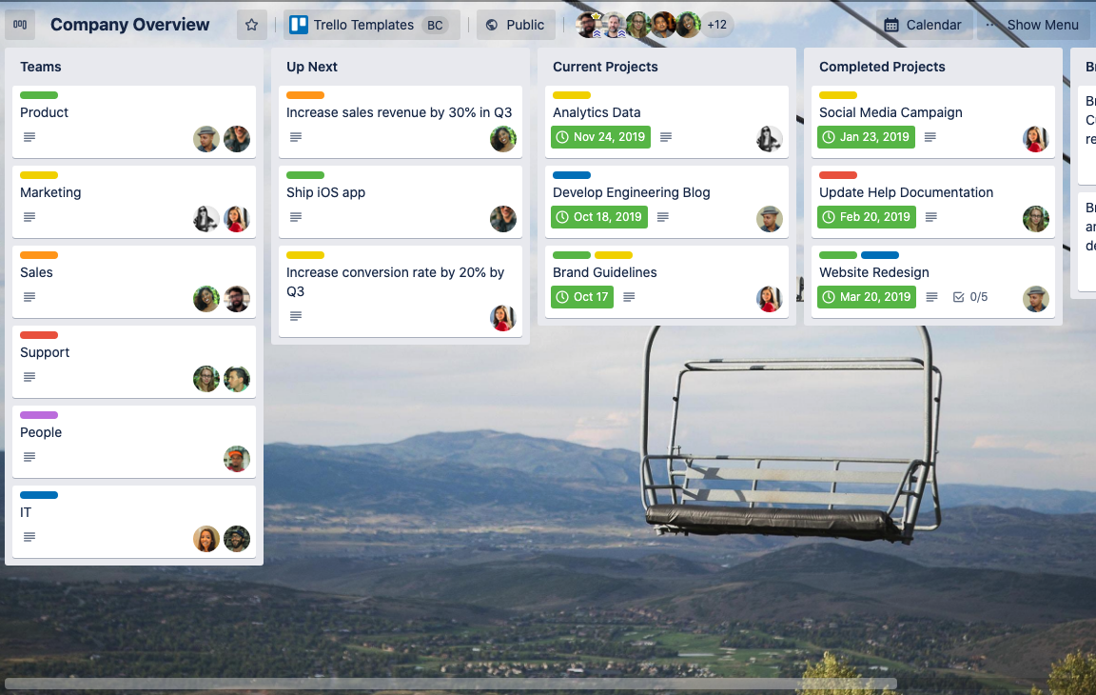
01
ABOUT TRELLO
Project management
List-making application
Notes:
This is a Trello board. Trello is a project management organize in a list-making application.
It helps to organize information and tasks, and see what is getting done.

Slide 4
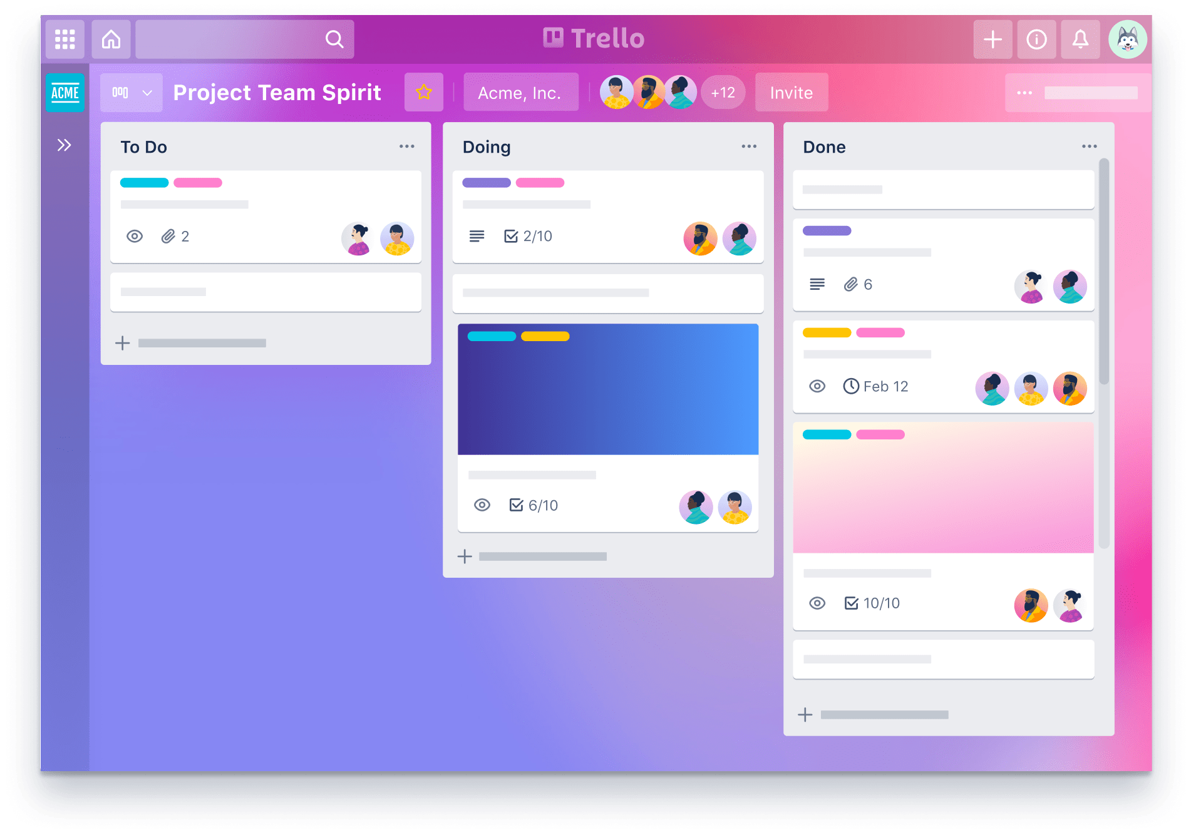
02
HOW IT WORKS
Users can create their task boards with different columns and move the tasks between them.
Typically columns include task statuses such as To Do, In Progress, Done.
Notes:
Trello bring perspective to the work team. You know who is doing what, and what need to get done.
You have all the information in one collaborative localization, which means less mails, meeting and more productivity.

Slide 5
Trello boards only have four key components, but they have infinite possibilities:
WORKSPACE
BOARDS
LISTS
CARDS
Notes:
Let's begin by boards.

Slide 6
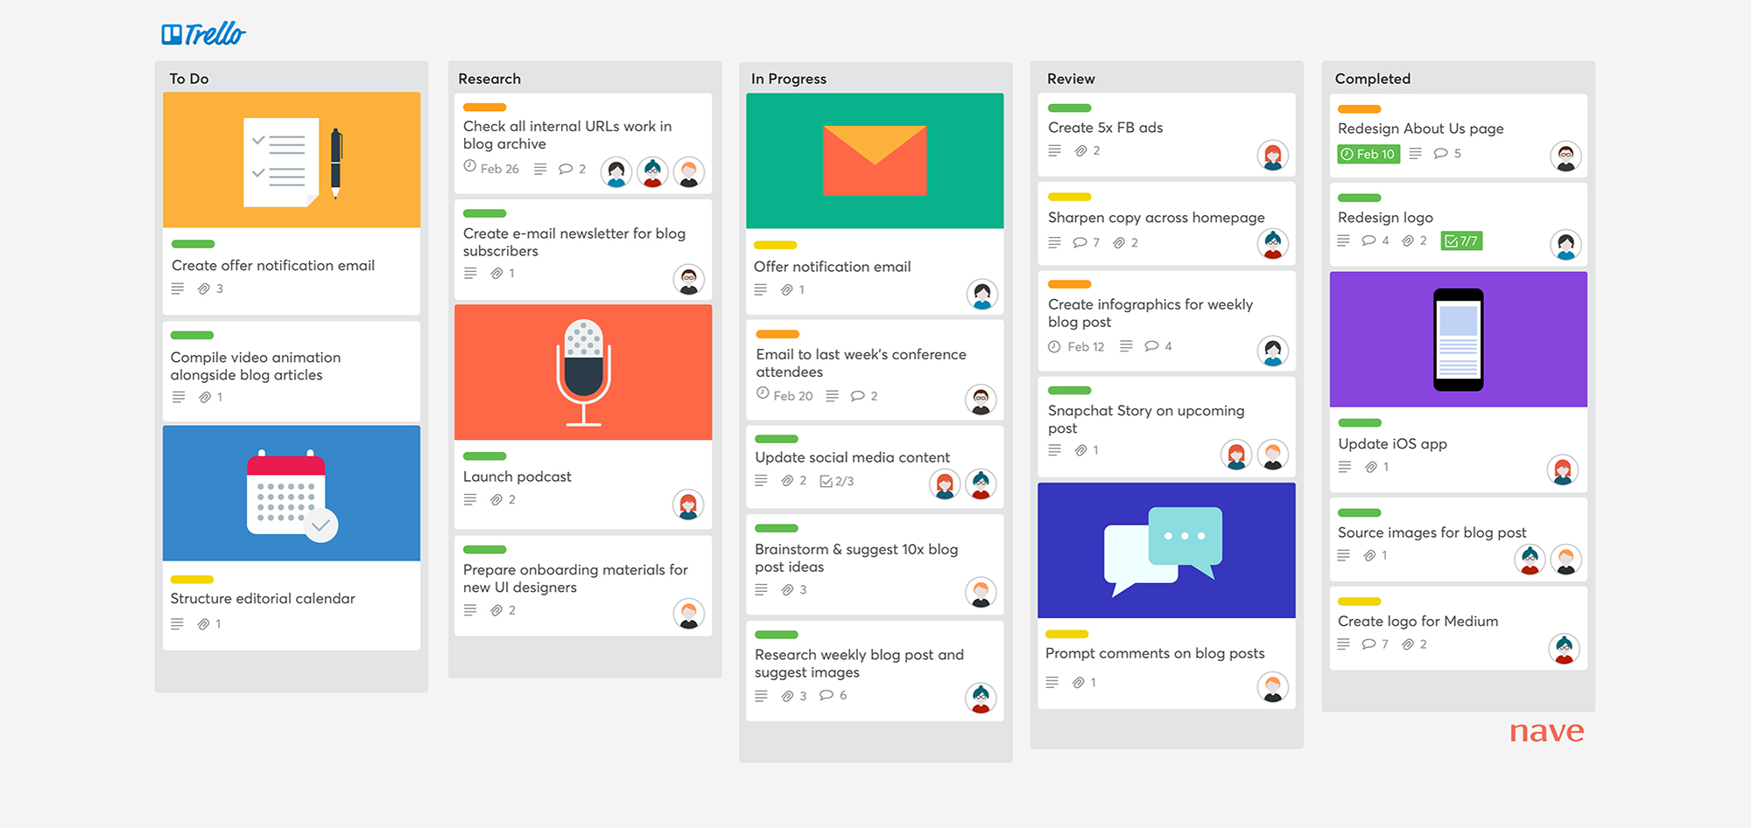
d)
CARDS
Card
Card
Card
Notes:
So, why i said we are starting by the end, because cards are the most basic Trello concepts
Cards are used to represent taks and ideas Like create offer notification emial or compile video animation.
Becase cards are insido of a list, tht will see in the next slide. We have a lot ot option for cards which are very functional and usufull to organize different jobs

Slide 7
c)
LISTS
List
List
List
List
List
Notes:
The list are made by cards. Here we have five list. They often represents a work Inside of a board you have lists and cards. Here we have five list.
Lists often represent a workflow or process.

Slide 8
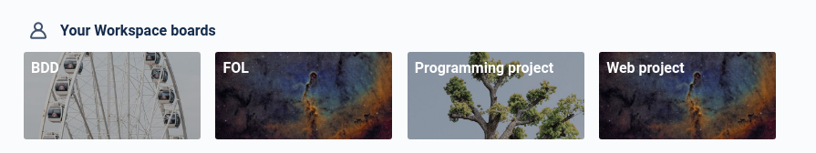
b)
BOARDS
Notes:
We can think of boards as project, for exemple, we can have one different board for each subject of the school.
One for Web, one for FOL.
And inside them you will have the to do lists for your workhome, your examens, etcera.

Slide 9
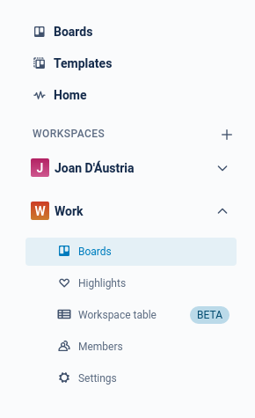
a)
WORKSPACES
Notes:
And beisicly, you can join projects of the same level or topic in a workspace. To illustrate this point you can think of two diferent workspace. One for work and another for the school.

Slide 10
03
TUTORIAL

Slide 11
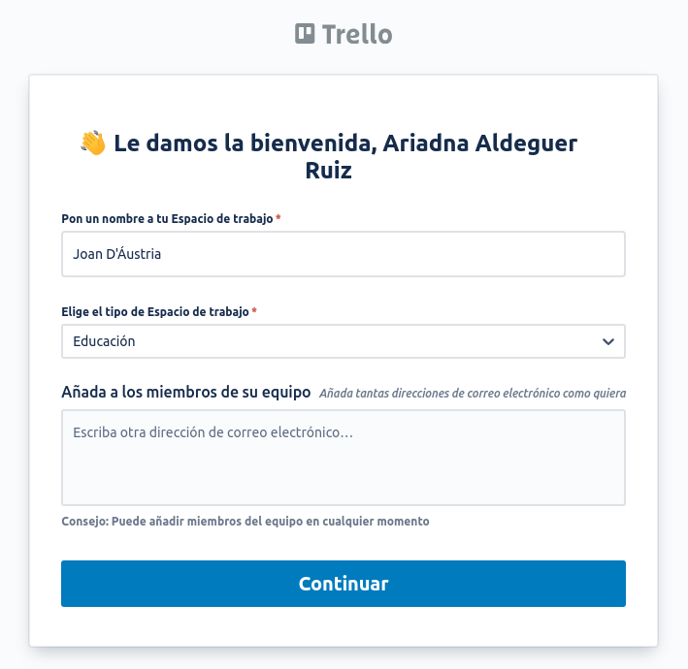
Notes:
Creating a trello board is easy! First of all, we need to sign in an account in trello and create our first workspase. In this case, we are creating one for the school.

Slide 12
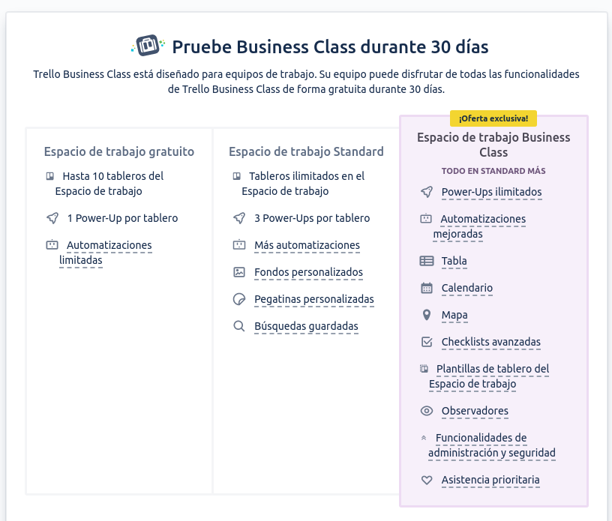
Notes:
Trello has differents options, a payment option and a free one.

Slide 13
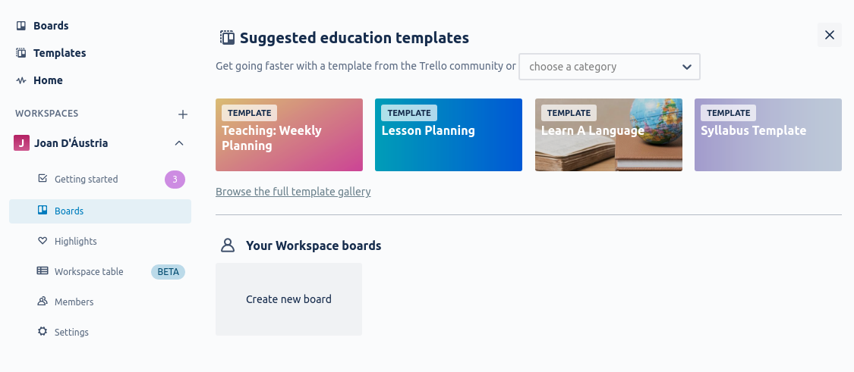
Notes:
click on “Create new board”

Slide 14
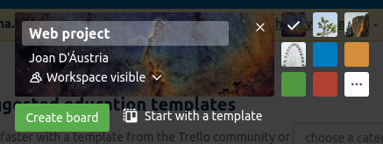
Notes:
and Name the board

Slide 15
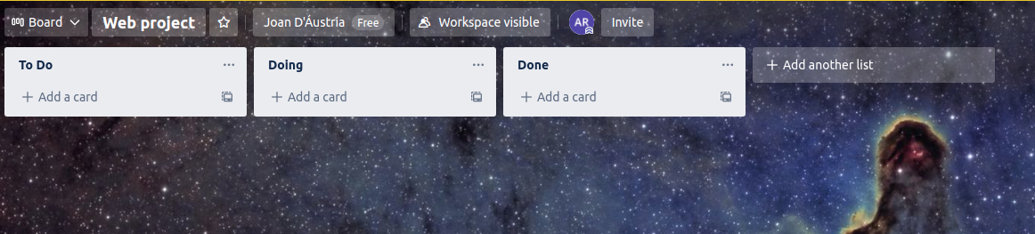
Notes:
Inside of the board, we can create different list, upon this, i’ll make “to do, doing, and done” lists”

Slide 16
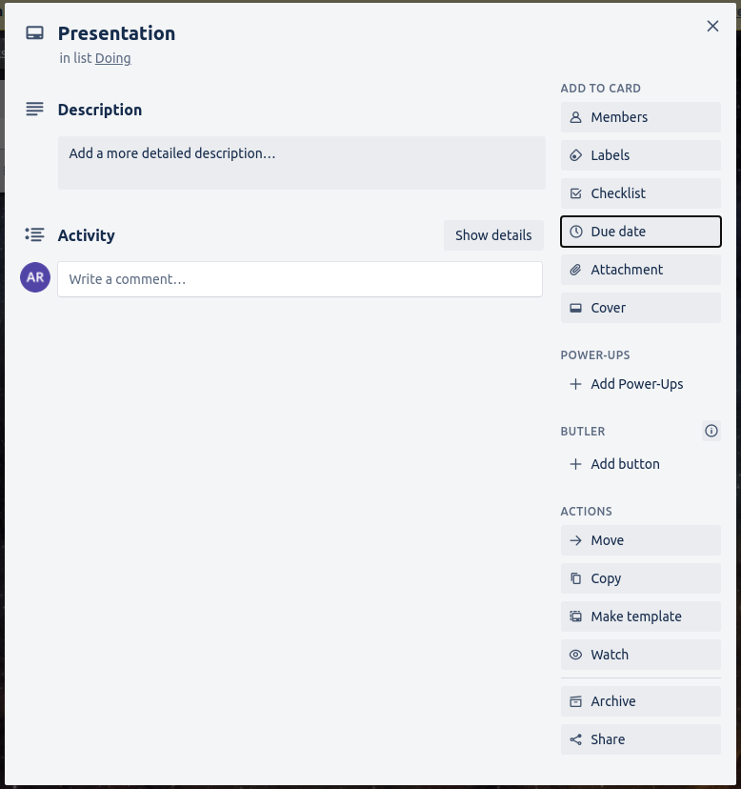
Notes:
In each list, you can choose completion dates,

Slide 17
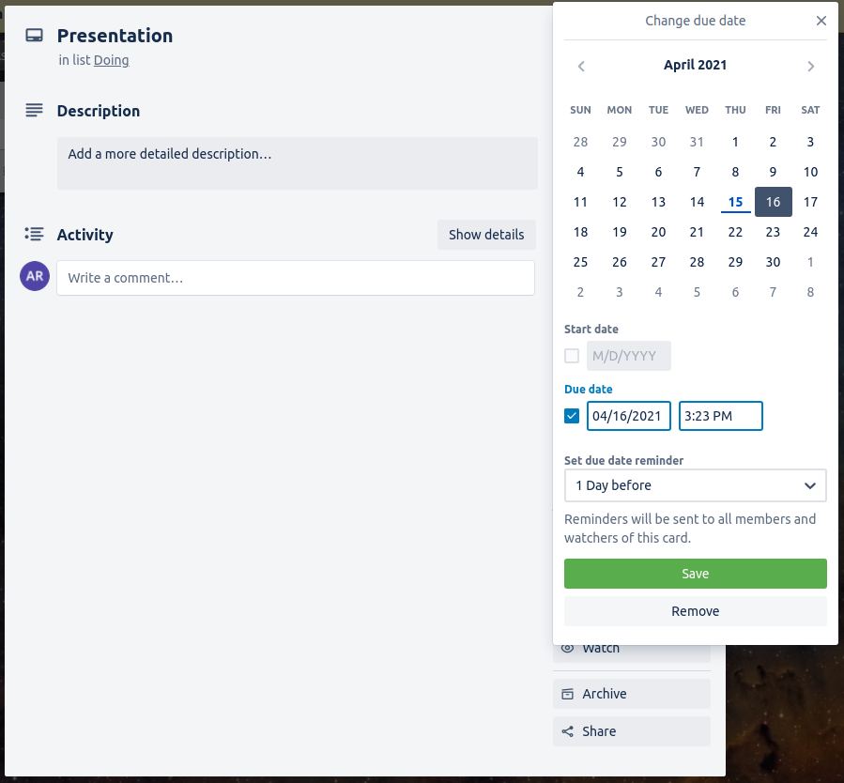

Slide 18
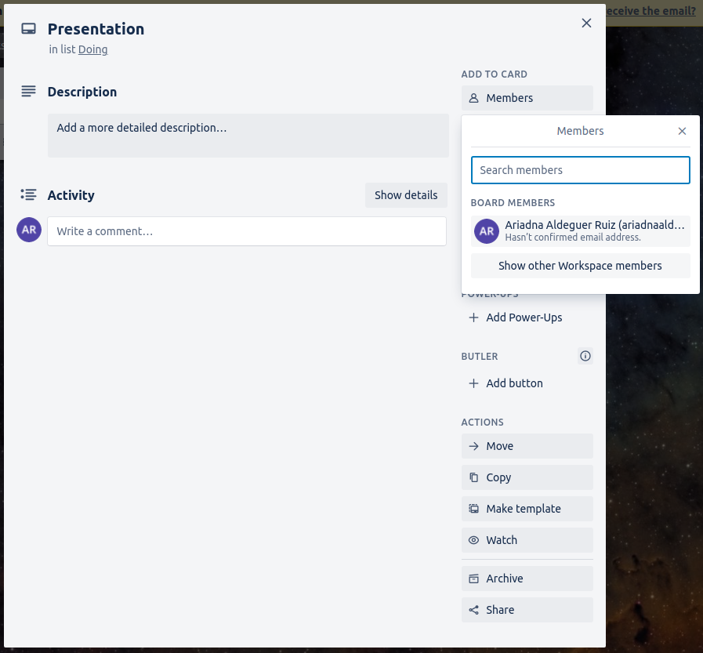
Notes:
Invite members

Slide 19
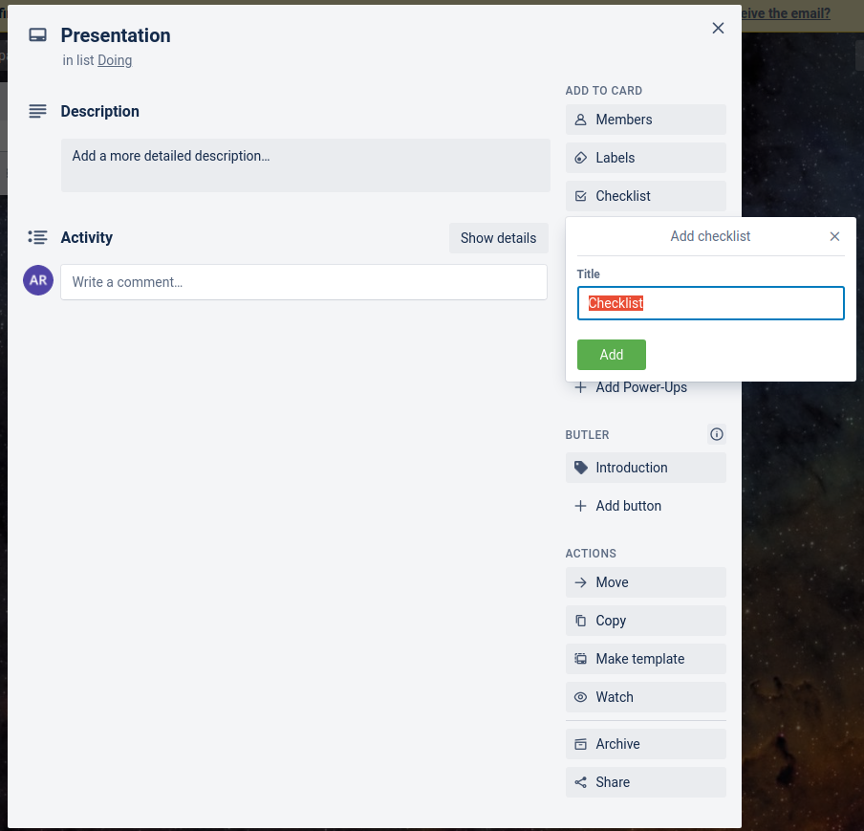
Notes:
Or add checklist on a task

Slide 20
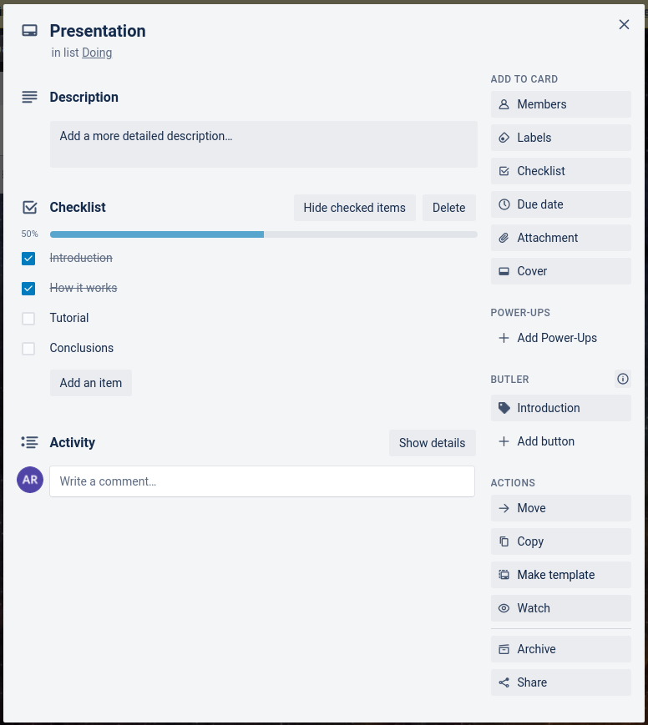

Slide 21
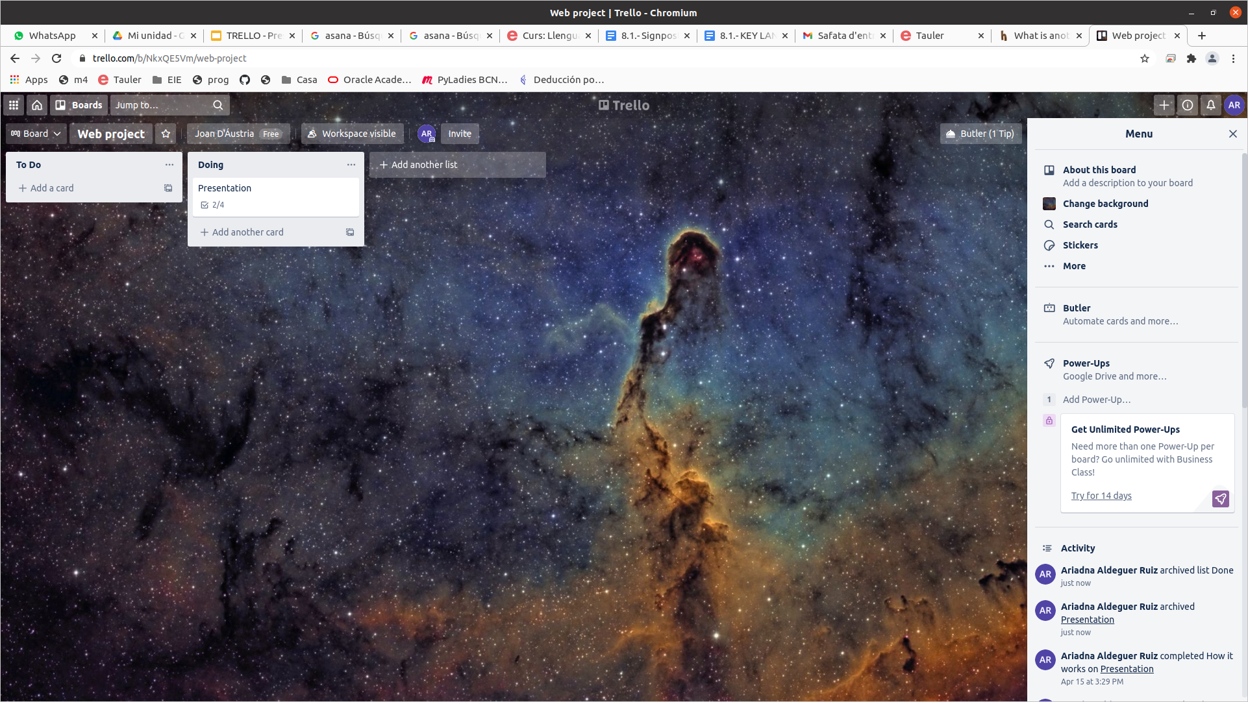

Slide 22
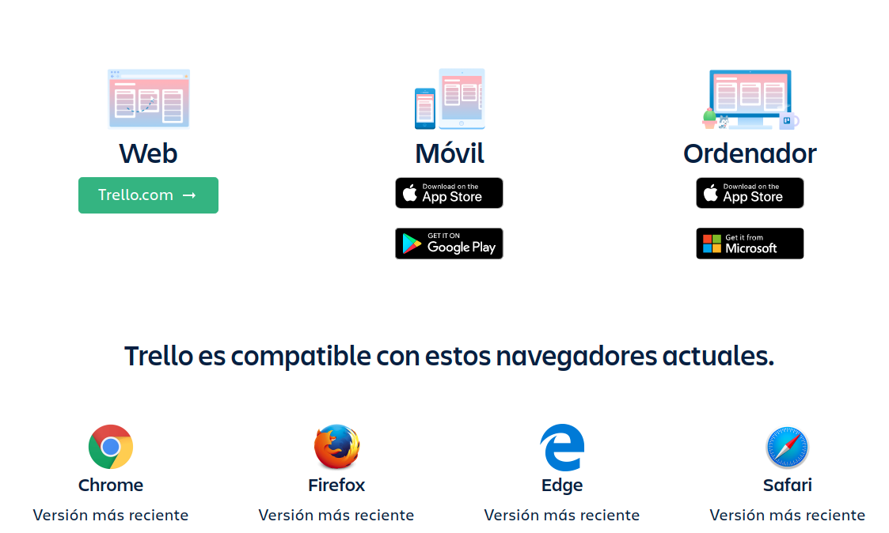
04
APPLICATIONS
Notes:
Trello has application web, movil and for computer. And it works all most of browsers.

Slide 23


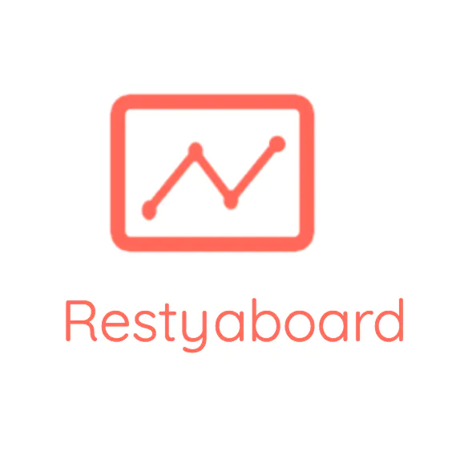

07
IT’S POSSIBLE TO MODIFY?
Python with Django and on top of AngularJS
PHP
PHP
written in JavaScript, based on the Meteor framework
Notes:
Trello can’t be modify. But there are opensource options like this. The most similiar to Trello is wekan.

Slide 24

08
COMPETITORS

Slide 25
THANKS

